Slide 1




HANDWRITTEN DIGIT RECOGNITION
TEAM MEMBERS:
PUSHPA MANGAL GOND
TEJASWINI PEERU GOUDA
DEEKSHITHA NARASIMHA
SWATHI K L
MEGHANA NAIK
VAISHNAVI V
NEHA B S

Slide 2
ABSTRACT
We are going to see how we can train a neural network model to recognize a handwritten digit which is given as an input to the model. The algorithm used to realize it is Convolution Neural Network (CNN).It is a network architecture for deep learning. It learns from the data which is through the images. It finds patterns in images and recognizes objects and categories. The CNN has several layers which takes the input, analyzes the input, and produces output. It's very much used in Deep Learning and very efficient in the modern world filled with AI

Slide 3
INTRODCUTION
In today's digital age, handwriting recognition is crucial for efficiently processing information. It involves converting handwritten characters into machine-readable formats, benefiting various applications such as license plate recognition, postal letter sorting, check scanning, and historical document preservation. To meet the demands of large databases, accuracy, low computational complexity, and consistent performance are essential.
Deep neural architectures, like convolutional neural networks (CNNs), have proven advantageous over shallow neural networks. CNNs are a specific type of deep neural network widely used in image classification, object recognition, recommendation systems, signal processing, natural language processing, computer vision, and face recognition.

Slide 4
PROBLEM STATEMENT
Handwritten digit recognition plays a vital role in various fields, from automated document processing to enhancing accessibility for individuals with disabilities. This project, titled "Handwritten Digit Recognition" aims to develop and implement a Convolutional Neural Network (CNN) model capable of accurately classifying handwritten digits. The focus is on leveraging a handcrafted dataset. The inherent challenges in recognizing diverse handwriting styles and variations necessitate the robustness of the CNN architecture, designed to capture hierarchical features in the input images. Through this project, we seek to achieve high classification accuracy and explore the intricacies of training a deep learning model on a custom dataset for handwritten digit recognition.

Slide 5
OBJECTIVE
The primary objectives of this project consists of the training and evaluation of a CNN model for handwritten digit recognition using the handcrafted dataset. The model's performance will be assessed based on metrics such as accuracy, and precision, with a keen focus on its ability to generalize the data. Ultimately, the project aims to provide brief study on the feasibility and effectiveness of CNNs in the context of handwritten digit recognition.

Slide 6
cHALLENGES
1. Overfitting: Overfitting is a common issue, where the model learns the training data too well and fails to generalize to unseen data. Regularization techniques and careful dataset augmentation are essential to mitigate overfitting.
2. Computational Complexity: Training deep neural networks, especially convolutional neural networks (CNNs), can be computationally intensive and time-consuming. Efficient hardware or distributed computing may be required for large-scale datasets.
3. Limited Dataset Size: The availability of a limited dataset may hinder the model's ability to learn diverse patterns. Techniques such as transfer learning or data augmentation are often employed to address this challenge.

Slide 7
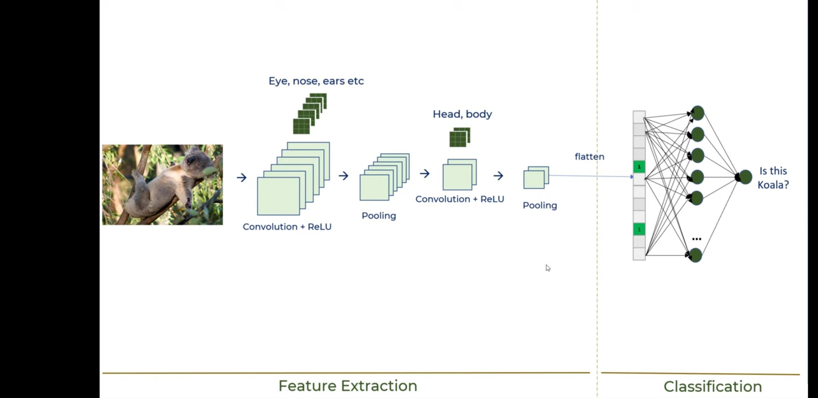
METHODLOGIES
1.Importing libraries: Libraries are useful tools that can make a web developer's job more efficient. It's a set of prewritten code, that we can call while programming our own code
2. Data Collection and Preprocessing: Collected a dataset of 1000 handwritten digit images. Preprocessed the images by resizing them to a consistent size (64x64), converting them to grayscale, and normalizing the pixel values.
3. Model Architecture: Designed a CNN architecture for handwritten digit recognition. The CNN architecture includes the following layers:
Convolutional layer(s): This layer extracts low-level features from the input image.

Slide 8
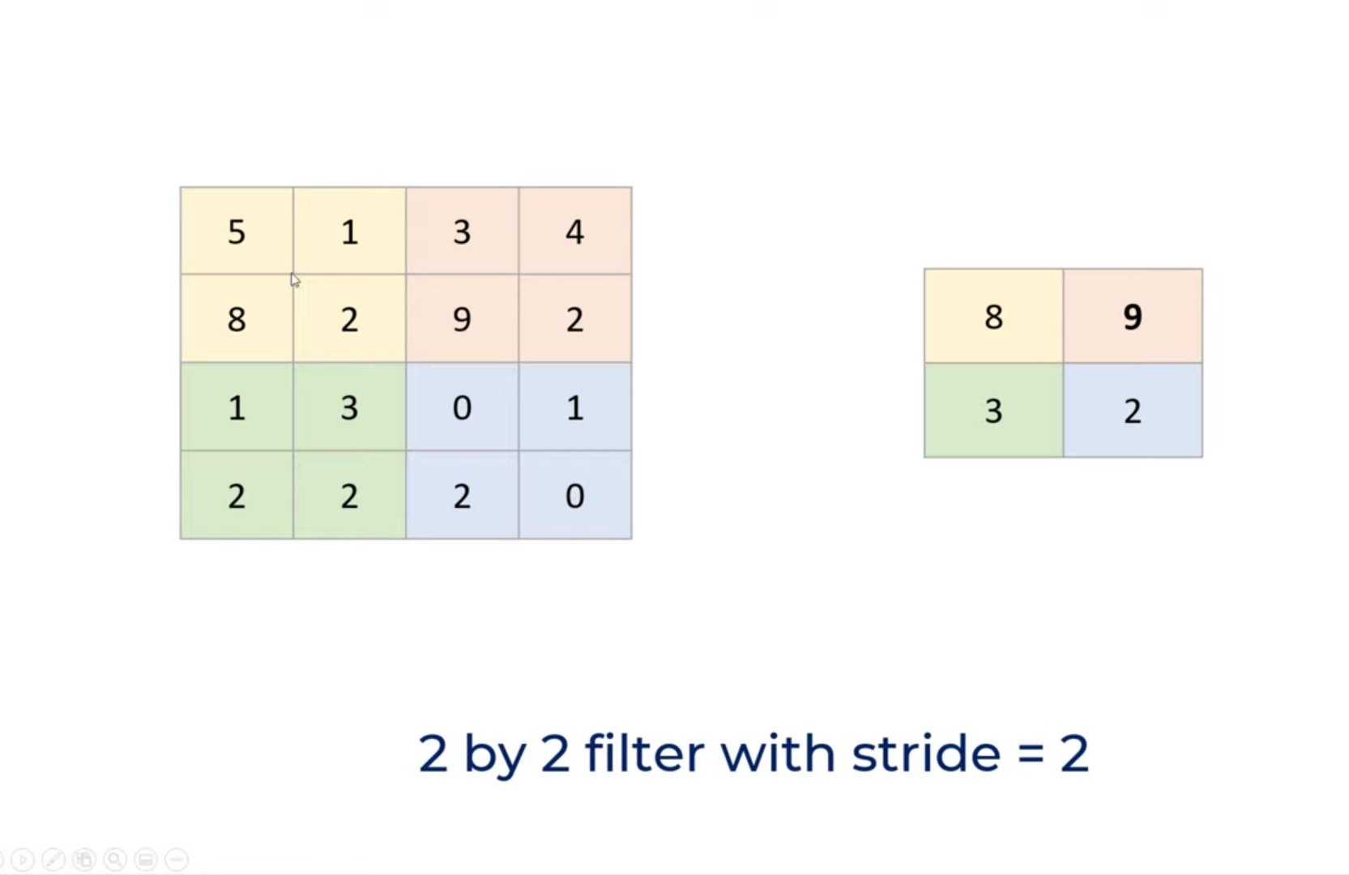
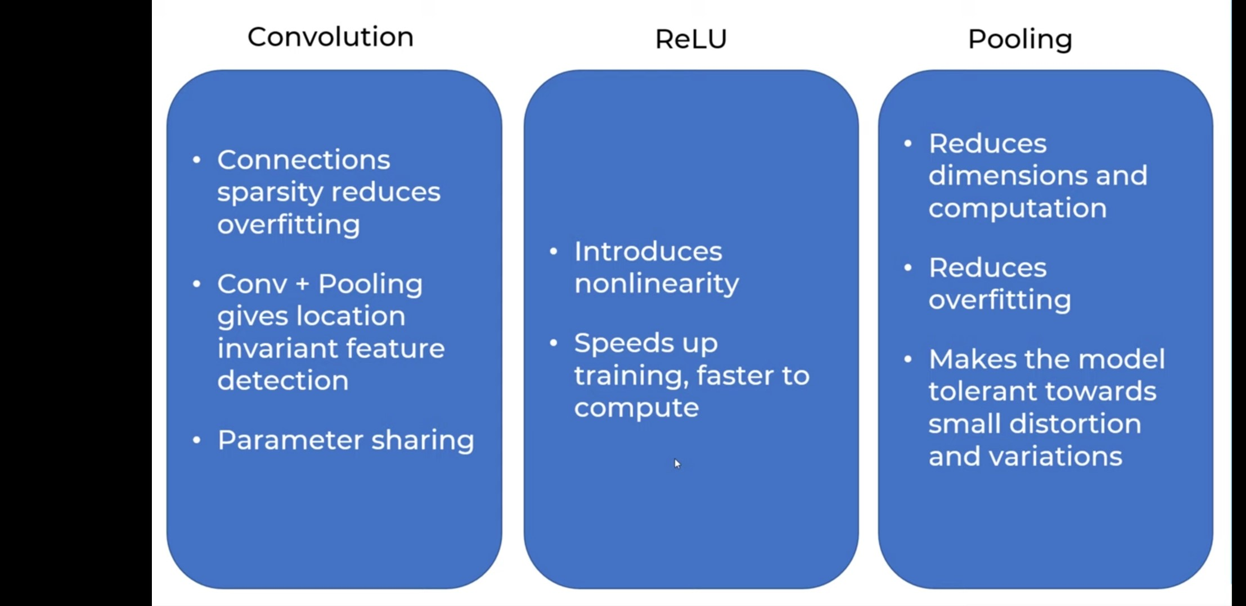
Max pooling layer(s): This layer reduces the dimensionality of the feature maps while preserving important information.
Flatten layer: This layer converts the feature maps from a 2D to 1D format.
Dense layer(s): This layer combines the high-level features extracted from the previous layers and outputs a probability distribution over the 10 digit classes

Slide 9
4.Training the Model: We are training the model using 2 dense layers, which combines to form a full connected layer. The 2 dense layers take 128,10. We flatten the pixels of the greyscale image in the input layer. Then we apply the activation functions to the weights in the hidden layer. The output layer gives the result as a prediction.
5.Testing the Model: Once the model is trained, we can use the loss function and accuracy function to test the model. We should have accuracy as high as possible and loss as less as possible to get the desired output (with accuracy being close to 1 and loss being close to 0). We used “ADAM” as our optimizer, “cross-entropy” as our loss and “accuracy” as our metrics.
6.Getting the output: We take a set of inputs and upload them into our model. Then we use a while loop to analyze each input individually and give the predictions for each image

Slide 10
implementation
1.Introduction:The handwritten digit recognition system operates on dataset of 1000 samples of custom hand written digits using Convolutional Neural Network model. Users can further interact with this model using a webapp interface. This webapp can effectively recognize the user’s input digit image rapidly and accurately.
2.Data Collection:The initial dataset will be in the form of collection of hand written digit images.
3.Data Preprocessing:The collection of images will be preprocessed and converted into binary matrix which represents the corresponding image. Preprocessing includes resizing the images to ensure consistent format, resolution, and orientation and splitting the dataset into training, validation, and test sets. The dataset consists of 1000 rows and 2 columns. The first column contains binary matrix, while the second column contains corresponding labels/digits. Each column has a significant number of unique values.
4.Model Architecture :It includes designing the CNN architecture and configuring the model with appropriate activation functions like ReLU, layers, and output units.
5.Model Training :The CNN model is trained on the training set, validating it on a separate validation set.
6.Model Evaluation: Model Evaluation consists of evaluating the trained model on the test set to assess its performance, calculating metrics such as accuracy and precision. The model will also will evaluated on real-world data of handwritten digit image

Slide 11
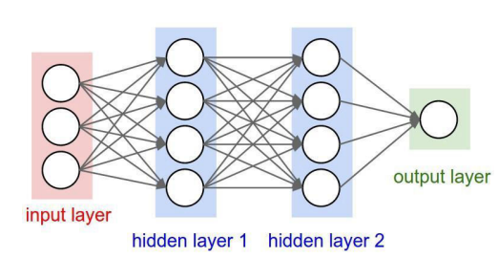
TOOLS AND ALGORITHMS USED
1. The neural network used is Sequential Model - Sequence models are basically the models in machine learning that analyze input sequences and produce output sequences of data. Sequential data includes audio clips, text streams, time-series data, video clips, etc. Recurrent Neural Networks (RNNs) is a majorly used algorithm used in sequence models. It's basically a linear path which connects all the input, hidden and the output layers without skipping any layers in between. A Sequential model is ideal for a plain stack of layers where each layer has exactly one input tensor, one or more hidden tensors and one output tensor.

Slide 12
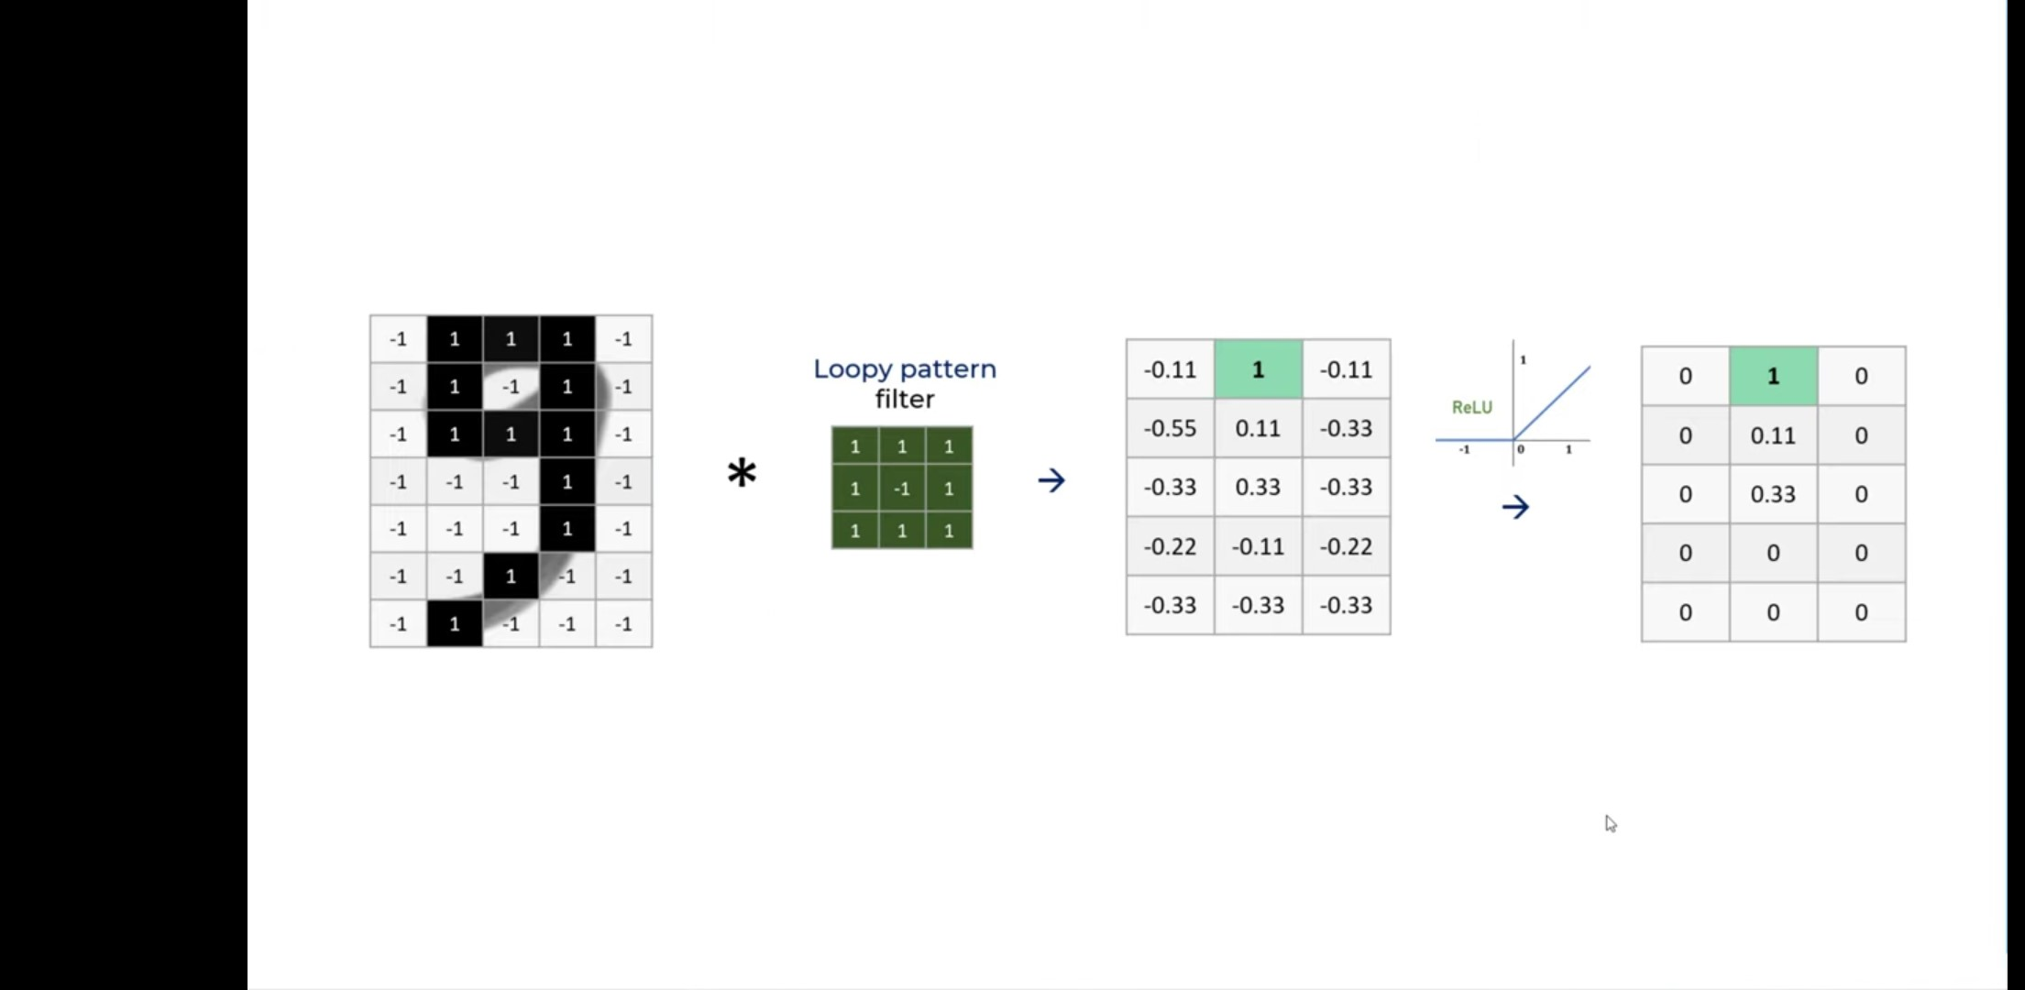
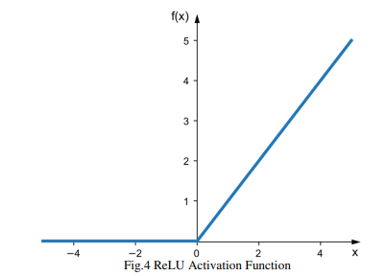
2. Activation functions used are:
a. ReLU - It stands for Rectified Linear Activation Function. It’s a piecewise linear function in which will produce output from the input directly when positive, or the output will be zero, as shown in Fig below. For many different types of neural networks, it is used as the default activation function networks since it's more convenient to train a model which uses this activation function to obtain better performance.
b.Softmax - It’s used as a function which can convert a vector of numbers into a vector of probabilities (whose value lies in between 0 and 1 with 1 being the most probable outcome). The probabilities of each value are proportional to the relative scale of each value in the vector.

Slide 13
3. Optimizer used in this code is ADAM –stands for Adaptive Moment Estimation. It is an algorithm and a technique to obtain gradient descent. This method is very effective in terms of working with large problems which also involves many parameters and data. Less memory is required and also, it’s a combination of the “RMSP” algorithm and the “gradient descent with momentum” algorithm. This is used to accelerate the above algorithm by taking the weighted average of the gradients into notice. For the algorithm, making use of the averages makes the minima lean towards a faster pace.
4. The loss function used is CROSS-ENTROPY– When trying to optimize particular or any classified models, Cross entropy is best suited for loss functions. Classification is a method of supervised learning which involves predictions of class labels using one or many input variables.
5. The metrics function used is ACCURACY– It is a function which determines the performance of the model. Metric functions are quite similar to loss functions but except for the fact that the outputs from evaluating a metric will not be used when training the model.

Slide 14
conclusion
From this implementation, we are able to identify the handwritten digits as input given to the code, analyze it and predict the probability output .With the code we are able to show that written data in MS paint application can be saved. Where the saved file is now loaded into the program and will run. With a while loop, we check each image and predict the value if multiple data set files are present. With this the image is analyzed by the already learnt neural connections and the grayscale pixels. It will now provide us with a prediction of the accurate output of recognized data. So, we can successfully recognize and digitalize our data. We are successfully able to understand and use Sequential Model, ReLU, SoftMax, adam, Cross-Entropy, Accuracy functions for image recognition.

